Slide 1
Diet Through the Decades: Nutrition as We Age
What should I eat and When?
Holly Herrington, RD
Center for Lifestyle Medicine

Slide 2
What do I need???
What should I eat in my 20’s? 30’s? 40’s?50’s?
How much should I take?
Do women needs specific nutrients? What about Multivitamins?
Can my diet prevent or delay developing chronic health issues?
Don't I need more as I age?
What about my bones?

Slide 3
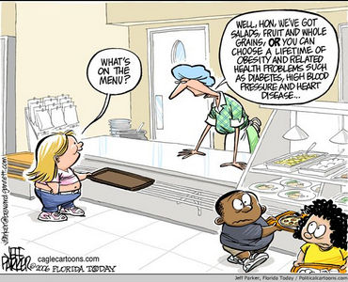

Slide 4
What should I eat in my 20’s? 30’s? 40’s?50’s?
Fact or Fiction?
For every decade of my life, I need different amounts of nutrients.

Slide 5
Our nutrition needs are not necessarily chronological
Dietary Reference Intakes (DRI) of Key nutrients for Women
Multivitamins
Specific Health Concerns
Heart Disease
Hypertension
Diabetes
Menopause
Bone Health
Sarcopenia
Brain Health
Calorie Needs
Controversial Foods
Superfoods
Fiction

Slide 6
DRI – Dietary Reference Intakes
How much should I take?
Do women needs specific nutrients? What about Multivitamins?
Water Soluble Vitamins
Fat soluble Vitamins
Calcium
Vitamin D
Iron
B Vitamins
Folate

Slide 7
I need HOW much?
Fat Soluble Vitamins:
Adult Females age 19-70 | RDI per day | Tolerable Upper Limit
Vitamin A | 500 -700 µg | 3,000 µg
Vitamin E | 12-15 mg | 1,000mg
Vitamin K | 90 µg | Not Determinable
Vitamin D
Adults up to age 71 | 600 IU
Age 71 and over | 800 IU
USDA. Dietary Reference Intakes: Recommended Intakes for Individuals. National Academy of Sciences. Institute of Medicine. Food and Nutrition Board.
Notes:
A Tolerable Upper Intake Level (UL) is the highest level of daily nutrient intake that is likely to pose no risk of adverse health effects to almost all individuals in the general population.
Not Determinable due to lack of data of adverse effects. Source intake should be from food only to prevent high limits of intake

Slide 8
Water Soluble Vitamins
B Vitamins | Ages | Mg per day
B6 | Age 19-50 Age 51+ | 1.3 1.7
B12 |  | 2.4
Folate | All ages | 400
 | Pregnant Lactating | 600 500
Vitamin C | All ages | 75 UL =2000
Food sources?
Fruits and veggies! Dark leafy greens, beans, yeast, fish, cheese, eggs, animal proteins Vitamin C: citrus fruits, peppers, broccoli, Kiwi, oranges, strawberries
USDA. Dietary Reference Intakes: Recommended Intakes for Individuals. National Academy of Sciences. Institute of Medicine. Food and Nutrition Board.
Notes:
Except in the situations of alcoholism and severe malnutrition, deficiency of B vitamins is rare.
B vitamins are essential to brain function, formation of red blood cells and building DNA
Because 10 to 30 percent of older people may malabsorb food-bound B12, it is advisable for those older than 50 years to meet their RDA mainly by consuming foods fortified with B12 or a supplement containing B12.
i

Slide 9
Calcium
Ages | Calcium Mg/ day
1 to 3 years | 700
4 to 8 years | 1,000
9 to 18 years | 1,300
19 to 50 years | 1,000
51 and older | 1,200
Food sources?
Dairy! Soy milk, Tofu, almonds, flax seed, yogurt, cheese, dark leafy greens, Herring
USDA. Dietary Reference Intakes: Recommended Intakes for Individuals. National Academy of Sciences. Institute of Medicine. Food and Nutrition Board.

Slide 10
Reference Daily Intakes (RDI)
for women ages 19-50
Vitamin A / 700 micrograms (mcg)
Vitamin C / 75 milligrams (mg)
Thiamin / 1.1 mg
Riboflavin / 1.1 mg
Niacin / 14 mg
Calcium / 1,000 mg
Iron / 18 mg
Vitamin D / 15 mcg*
Vitamin E / 15 mg
Vitamin B6 / 1.3 mg
Pantothenic acid / 5 mg
Potassium/ 4.7 grams
Folic acid / 400 mcg
Vitamin B12 / 2.4 mcg
Phosphorus / 700 mg
Iodine / 150 mcg
Magnesium / 315 mg
Zinc / 8 mg
Copper / 900 mcg
Biotin / 30 mcg
USDA. Dietary Reference Intakes: Recommended Intakes for Individuals. National Academy of Sciences. Institute of Medicine. Food and Nutrition Board.

Slide 11
Reference Daily Intakes (RDI)
for women ages 51-70
Vitamin A - 700 micrograms (mcg)
Vitamin C - 75 mg
Thiamin - 1.1 mg
Riboflavin - 1.1 mg
Niacin - 14 mg
Calcium - 1,200 mg
Iron - 8 mg
Vitamin D - 15 mcg*
Vitamin E - 15 mg
Vitamin B6 - 1.5 mg
Pantothenic acid - 5 mg
Potassium - 4.7 grams
Folic acid - 400 mcg
Vitamin B12 - 2.4 mcg**
Phosphorus - 700 mg
Iodine - 150 mcg
Magnesium - 320 mg
Zinc - 8 mg
Copper - 900 mcg
Biotin - 30 mcg
USDA. Dietary Reference Intakes: Recommended Intakes for Individuals. National Academy of Sciences. Institute of Medicine. Food and Nutrition Board.

Slide 12
MULTIVITAMINS
Fact or Fiction:
I can meet my nutrition needs by taking a daily multivitamin
*1 in 3 Americans report taking multivitamins and/or
minerals regularly

Slide 13
FICTION
Meant to supplement, or fill in the gaps, of a healthy diet
Downside:
Not all multis are made the same, quality can vary
Are not all regulated –may have varying amounts
Will NOT improve health, prolong life or reduce
incidence of developing disease

Slide 14
FICTION
Repeated studies find little or NO long lasting benefit from taking a multivitamin
Park, Murphy, Wiliams, Henderson and Kolonel (2011)
Multivitamin Use and the Risk of Mortality and Cancer Incidence: The Multiethnic Cohort Study Am. J. Epidemiol. 173(8): 906-914
Over 182,000 midle aged men and women in CA and HI took multivitamins regularly. Lived no longer and were no less likely to be diagnosed with cardiovascular disease or cancer than those who didn’t take a multi.
Neuhouser et al (2009) Multivitamin Use and Risk of Cancer and Cardiovascular Disease in the Women's Health Initiative Cohort Arch. Int Med 169:294
41% of over 161,000 postmenopausal women in the Women’s Health Initiative Cohorts who were taking a multi were just as likely to be diagnosed with breast, ovarian, colorectal or another cancer as those who did not take a multi
Notes:
Multiethnic cohort study: over 182K people followed for 14 years to assess the relation between muilti use, mortality and cancer

Slide 15
Exceptions?
Diabetes
Hypomagnesemia in diabetes was associated with poorer glycemic control, retinopathy, nephropathy, and foot ulcers
Mg may curb insulin resistance
Overweight population
Up to 350 mg/ day

Slide 16
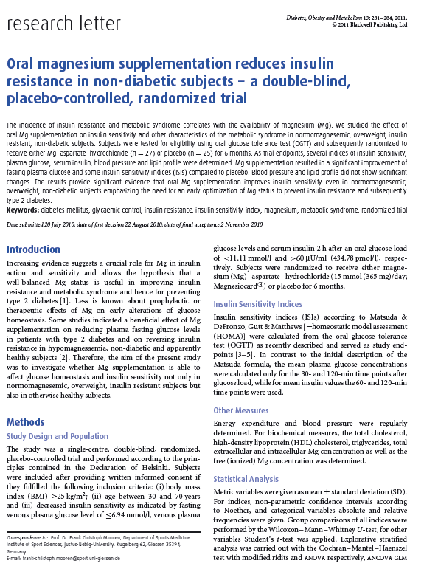
The results of the study provide significant evidence that Mg supplementation ameliorates insulin resistance in obese, insulin-resistant subjects.
Fasting plasma glucose was significantly lower in the Mg
group
Diabetes, Obesity and Metabolism 13: 281–284, 2011.

Slide 17
Food Sources of Mg?
Bran, rice, wheat, oats, squash, pumpkin, flax, seeds, almonds, soybeans
Diabetes, Obesity and Metabolism 13: 281–284, 2011.

Slide 18
HTN, Heart Disease, Osteoporosis
low levels of Mg have been linked with heart disease and osteoporosis
Low levels of K have been linked with HTN
there is little to no evidence to support taking supplements, antioxidants, Vitamins A, C or E, calcium, folate, B supplements or soy can prevent these disease

Slide 19
SO how Can I prevent or delay developing chronic health issues?

Slide 20
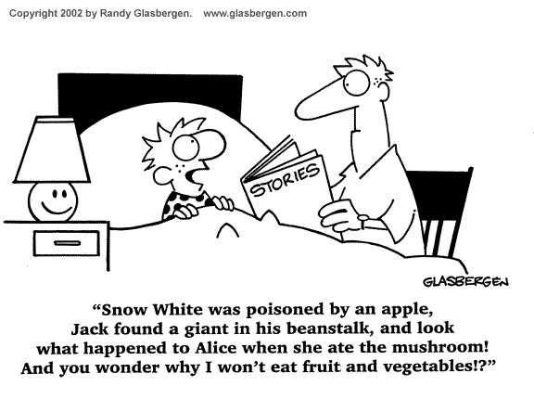

Slide 21
Hypertension
Potassium
American Heart association:
A diet that includes natural sources of potassium is important in controlling blood pressure because potassium lessens the effects of sodium. The recommended daily intake of potassium for an average adult is about 4,700 milligrams per day.
Food Sources of Potassium?
Beans, dark leafy greens, potatoes, oranges, apricots, avocados, mushrooms, fish, bananas

Slide 22
Hypertension
Sodium
2000 mg/day for most healthy individuals
1500 mg/day for:
adults over the age of 51
African American
HTN
CKD
DM

Slide 23
Heart Disease
Total Fat, Saturated Fat and Trans Fat Recommendations by Calorie Level - AHA
Calorie Level Daily | Total Fat 30% or Less (grams) | Saturated Fat Less than 7% (grams) | Trans Fat Less than 1% (grams) | Calorie Level Daily
1200 | 40 or less | Less than 9 | Less than 1 | 1200
1500 | 50 or less | Less than 12 | Less than 1 | 1500
1800 | 60 or less | Less than 14 | Less than 1 | 1800
2100 | 67 or less | Less than 16 | Less than 2 | 2100
2200 | 73 or less | Less than 17 | Less than 2 | 2200
2500 | 83 or less | Less than 19 | Less than 2 | 2500
Fiber = 25-35 g
Soluble Fiber 10 g

Slide 24
Heart Disease
Soluble Fiber Helps lower blood cholesterol | Insoluble Fiber Aids in normal bowel function
Oats, oat bran, oatmeal | Whole grains
Beans (black, pinto, kidney, white, ) | Whole grain pasta
Peas | Whole grain breads & crackers
Rice bran | Whole grain cereals
Barley | Brown rice
Citrus fruits, pears, apple pulp | Other fruit
Brussel sprouts | Vegetables
Recommendations:
Total fiber goal = 25-30 grams/ day
Soluble fiber goal = 10 grams
on average accompanied by a 5% reduction in LDL cholesterol

Slide 25
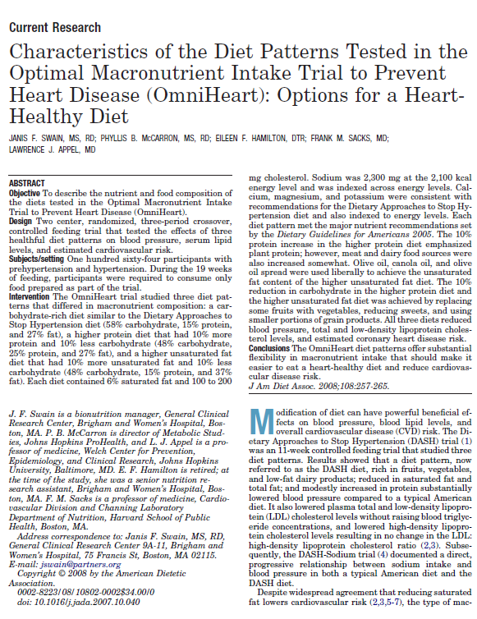
3 variations of a fruit and veggie rich diet
Low fat
Low sodium (>2300mg)
Low sugar
High potassium (4700 mg day)
High Mg (500 mg)
High Calcium (1200 mg)
High fiber (30g)
Lowered Systolic blood pressure by 13-16 points
Lowered LDL cholesterol up to 24 points
Lowered triglycerides up to 16 points
Notes:
Middle aged Americans have a 90 percent chance of developing high blood pressure
3 variations: carb rich (high fiber, low sugar)
High protein (non animal sources)
High unsaturted fat diet (mostly canola and olive oil)
The purpose of this review is to highlight findings of three large-scale, isocaloric feeding studies: the Dietary Approaches to Stop Hypertension (DASH) trial, the DASH-Sodium trial, and the Optimal Macro-Nutrient Intake to Prevent Heart Disease (OmniHeart) trial. Each of these trials tested the effects of diets with different macronutrient profiles on traditional cardiovascular disease (CVD) risk factors (ie, blood pressure and blood lipids) in the setting of stable weight. The DASH and DASH-sodium trials demonstrated that a carbohydrate-rich diet that emphasizes fruits, vegetables, and low-fat dairy products and that is reduced in saturated fat, total fat, and cholesterol substantially lowered blood pressure and low-density lipoprotein cholesterol. OmniHeart demonstrated that partial replacement of carbohydrate with either protein (about half from plant sources) or with unsaturated fat (mostly monounsaturated fat) can further reduce blood pressure, low-density lipoprotein cholesterol, and coronary heart disease risk. Results from these trials highlight the importance of macronutrients as a determinant of CVD risk. Furthermore, these results also document substantial flexibility that should enhance the ability of individuals to consume a heart-healthy diet.

Slide 26
Recommendations for Fruits and Veggie Intake
2 cups of fruit per day
2.5 cups of veggies per day
½ cup cooked or 1 cup raw
What does 4.5 cups/day look like?

Slide 27
What does 4.5 cups/day look like?

Slide 28
Fish
Fish ≥ 2 x/week
Cold Water Fish
Salmon, Mackerel, Tuna, Herring, Lake Trout, Sardines
1 serving = 3-4 ounces
8 ounces per week
3 ounces = deck of cards
3 ounces salmon =
1,800 mg omega-3’s
Notes:
Lovaza (Omacor) max dose is 4g/day each tab = 1 g
Fish high in omega-3 fatty acids include:
Anchovies
Wild salmon
Mackerel (Pacific, Atlantic, and jack)
Sablefish
Whitefish
Pacific sardines
Bluefin tuna
Atlantic herring
Rainbow trout

Slide 29
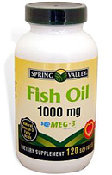
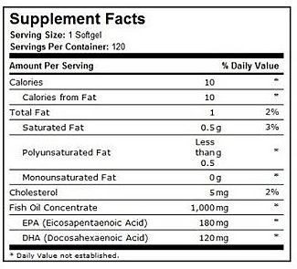
Should add up to 1000 mg

Slide 30
Menopause
Weight Gain CAN be prevented or minimized
reduced calories
Increased physical activity, especially muscle strengthening
Low fat, plant based diet
high sugar, high fat diet has
been associated with night
sweats and hot flashes
Am J Clin Nutr. 2013 May;97(5):1092-9. doi: 10.3945/ajcn.112.049965. Epub 2013 Apr 3.

Slide 31
Bone Health
Calcium
Vitamin D
Potassium
higher excretion of K is associated with greater %LBM in healthy older women
Alkaline Diets
favor lean tissue mass
Metabolic Acidosis promotes
muscle wasting: diets rich in acid
producing proteins may contribute
to a reduction in lean tissue mass

Slide 32
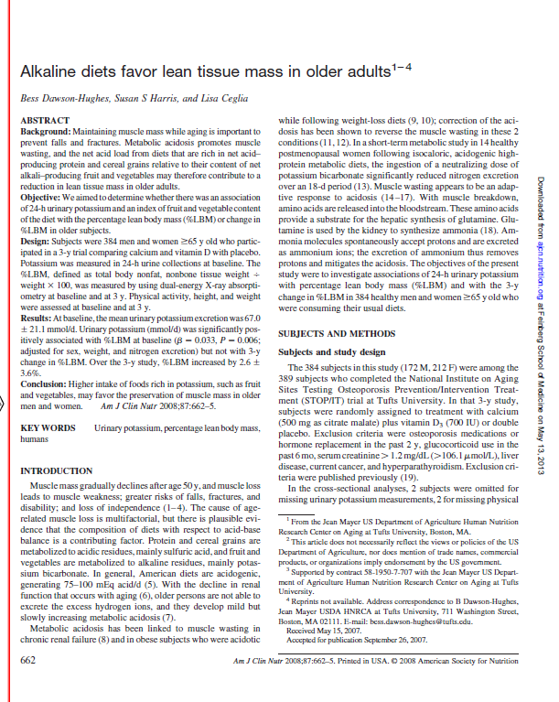
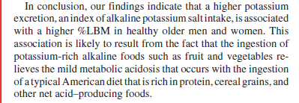
National Institute on Aging Sites Testing Osteoporosis Prevention/Intervention Treatment
(STOP/IT) trial at Tufts University.
Am J Clin Nutr 2008;87:662–5
Notes:
The 384 subjects in this study (172 M, 212 F) were among the
389 subjects who completed the National Institute on Aging
Sites Testing Osteoporosis Prevention/Intervention Treatment
(STOP/IT) trial at Tufts University.

Slide 33
Preserving Muscle Mass
Resistance Training
improves bone mineral density
Can reduce A1c% in persons with DM
Reduce incidence of falls
Protein:
DRI = 0.36g for every pound
May keep you healthy but may not be
enough to prevent muscle loss as we age
Aim for 25 -50% more protein than the DRI

Slide 34
Preserving Muscle through Protein
Protein Intake:
Older individuals need a larger amount of amino acids to stimulate protein synthesis
Above age 60, cells resist making new tissue after consuming small amounts of protein
For optimal muscle synthesis:
30g high quality protein per meal
J. Am. Diet. Assoc. 109:1582,2009

Slide 35
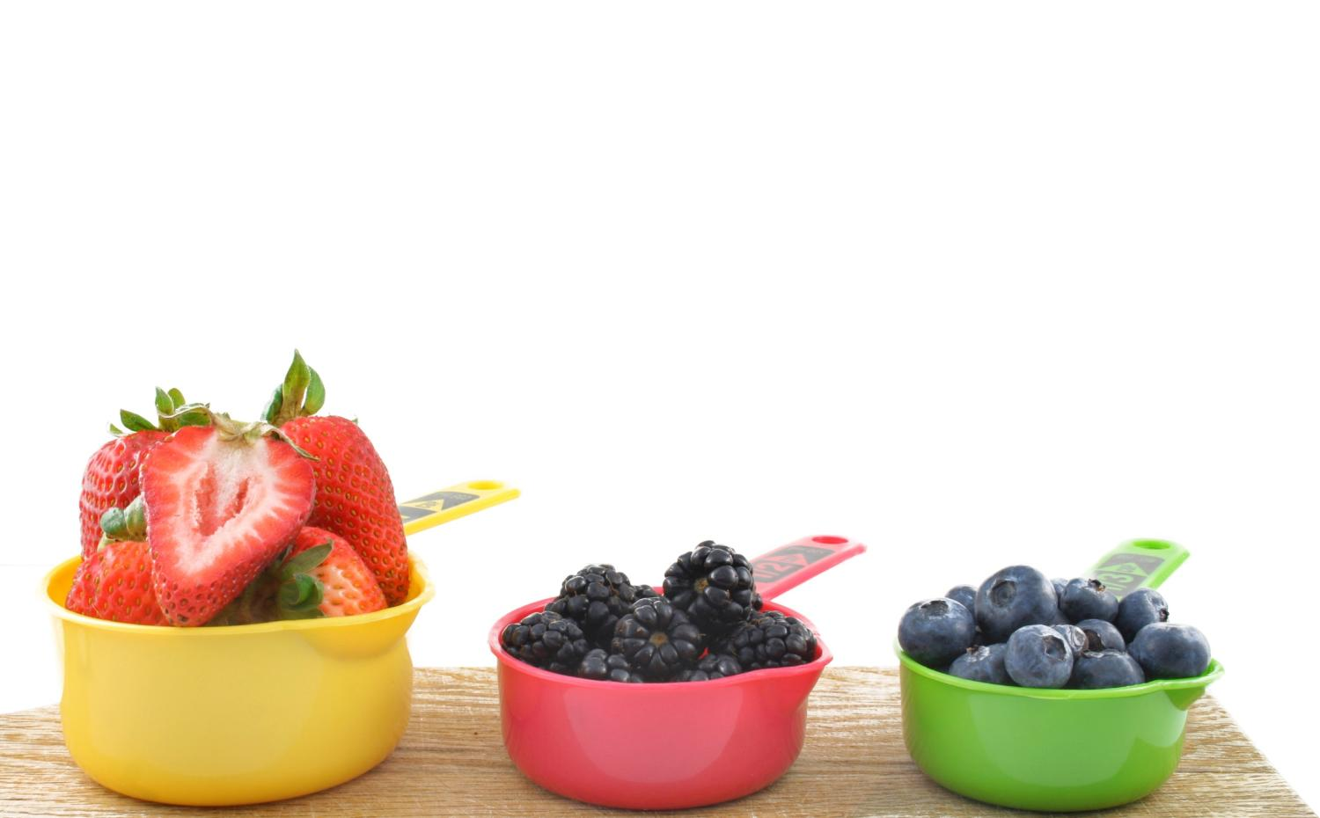
2010 Dietary Guidelines
“Poor diet and Physical inactivity are the most important factors contributing to an epidemic of overweight and obesity affecting men, women and children in all segments of our society.”
Dietary Guidelines for Americans 2010. http://www.cnpp.usda.gov/DGAs2010-PolicyDocument.htm
Notes:
Now that we know and are going to be more mindful of making sure our meals contain more color… we are going to review how much of these colorful fruits and vegetables we should eat each day. Everyone is probably aware that only an estimated 30% of Americans actually consume adequate amounts of fruits and vegetables.
It is recommended that we each eat 2 cups of fruit and 2 ½ cup of vegetables each day.
Just by making a few small changes to increase fruits and vegetables into your meals, you can boost your defenses against chronic diseases.
If you are not try, starting slow and eat more than you usually consume. Add some blueberries or strawberries to your breakfast cereal. Choose a colorful salad as a side dish instead of fried potatoes or chips at lunch or dinner. Layer sandwiches with tomatoes and greens. And speaking of salads, start with deep green and/or red lettuces and use your imagination to add colorful items such as grapes, berries, and orange slices. When fresh fruits and vegetables are not available, frozen is a great economical option.
Bottom line, we eat with our eyes and a colorful plate of food is much more appetizing than one filled with browns and beiges. Do yourself a favor and add more vibrant color into your diet.

Slide 36
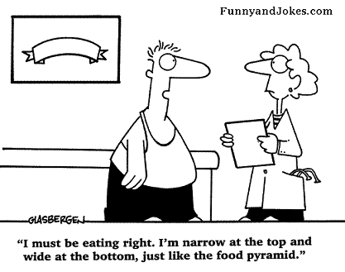
Calories
Your calorie needs Differ

Slide 37
Calories
Current weight (lbs) x 10 = how many calories you need to MAINTAIN your weight
250 lbs x 10 = 2500 kcal
Current weight (lbs) x 7 = how many calories you need to lose weight
250 x 7 = 1750 kcal
Individual Calorie needs vary
Age
Weight
Height
Activity levels
Health status
On average we need:
1800-2000 calories for weight mgmt
1200-1500 calories for weight loss

Slide 38
Calories
Total Calorie Breakdown:
50% carbohydrate
Whole grains
30g fiber per day
20% Lean Protein
30% Fat
Mono & polyunsaturated

Slide 39
Normal = 18.5-24.9
Overweight = 25-29.9
Obese = 30+
Morbid Obesity = 40+
All adults ages 18-65 should aim for the “Normal” BMI category
Over 65 –aim for the “overweight” category
Body Mass Index
To calculate BMI using kilograms and meters
BMI = weight (kilograms)
height squared (m²)
To calculate BMI with pounds and inches
BMI = weight (pounds) x 703
height squared (inches²)
Quick calculation = lbs x 703 / in / in
Jensen MD. Obesity In: Goldman L, Schafer AI, eds. Cecil Medicine. 24th ed. Philadelphia, Pa: Saunders Elsevier; 2011:chap 227.
Gahagan S. Overweight and obesity. In: Kliegman RM, Behrman RE, Jenson HB, Stanton BF, eds. Nelson Textbook of Pediatrics. 19th ed. Philadelphia, Pa: Saunders Elsevier; 2011:chap 44

Slide 40
The Theory of Dairy Calcium
Low Calcium Intake
High Adipocyte Calcium
Lipolysis
Lipogenesis
Vitamin D-Related Mechanism
Increased Fat Storage
Conversely, high intakes of calcium may contribute to decreased fat storage.
Zemel MB, AJCN 2004
Notes:
It is theorized that:
Reduced dietary calcium leads to transfer of calcium from bone to blood. Kidneys reabsorb calcium, and intestines increase calcium absorption.
Calcium accumulates in fat cells, which stimulates expression of lipogenic genes, increasing fat formation and inhibiting fat breakdown.
Conversely, ↑ dietary calcium decreases fat storage and increases fat breakdown.
Zemel notes that dairy is more effective than supplements, suggesting the dairy products have beneficial bioactive compounds.
Reference:
Zemel MB. Role of calcium and dairy products in energy partitioning and weight management. Am J Clin Nutr. 2004 May;79(5):907S-912S

Slide 41
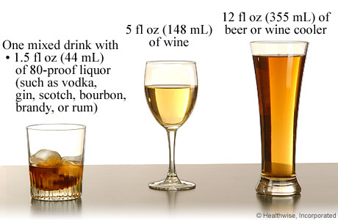
Alcohol
Moderate alcohol to help prevent heart disease
< 1 drink/day women or < 2 drinks/day men
1 drink = 100-150 calories
1.5 oz liquor
12 oz beer
4 oz wine
Drinking more alcohol increases such dangers as alcoholism, high blood pressure, obesity, stroke, breast cancer, suicide and accidents.
The American Heart Association cautions people NOT to start drinking ... if they do not already drink alcohol. Consult your doctor on the benefits and risks of consuming alcohol in moderation.

Slide 42
The Joy of Soy!
Americans as a whole still consume very little soy protein.
Based on 2003 data from the UN Food and Agriculture Organization, per-capita soy protein consumption is less than 1 gram (g) per day in most European and North American countries
The Japanese, on the other hand, consume an average 8.7 g of soy protein per day; Koreans, 6.2–9.6 g; Indonesians, 7.4 g; and the Chinese, 3.4 g.
Lower rates of heart disease, cancer and HTN
soy foods can certainly be a part of a healthy diet— particularly soy foods such as tofu and edamame (green soybeans) typical of the Asian diet.
Soy-protein bars, soy shakes and other Americanized concoctions may not be made from whole soybeans and can contain added sweeteners, so check the label.

Slide 43
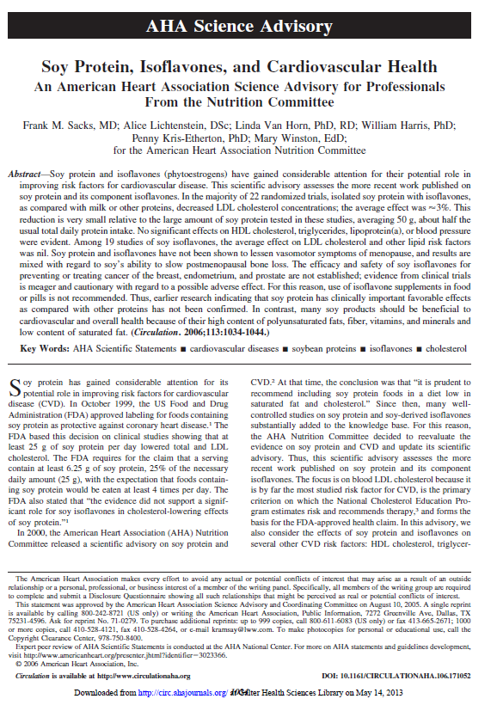
In the majority of 22 randomized trials, isolated soy protein with isoflavones, decreased LDL cholesterol concentrations. -Soy protein and isoflavones have not been shown to lessen vasomotor symptoms of menopause, and results are mixed with regard to soy’s ability to slow postmenopausal bone loss. -efficacy and safety of soy isoflavones for preventing or treating cancer of the breast, endometrium, and prostate are not established -evidence from clinical trialsis meager and cautionary with regard to a possible adverse effect. -isoflavone supplements in food or pills is not recommended. - many soy products should be beneficial to cardiovascular and overall health because of their high content of polyunsaturated fats, fiber, vitamins, and minerals and low content of saturated fat.
(Circulation. 2006;113:1034-1044.)
Notes:
Soy protein and isoflavones (phytoestrogens) have gained considerable attention for their potential role in
improving risk factors for cardiovascular disease. This scientific advisory assesses the more recent work published on
soy protein and its component isoflavones. In the majority of 22 randomized trials, isolated soy protein with isoflavones,
as compared with milk or other proteins, decreased LDL cholesterol concentrations; the average effect was 3%. This
reduction is very small relative to the large amount of soy protein tested in these studies, averaging 50 g, about half the
usual total daily protein intake. No significant effects on HDL cholesterol, triglycerides, lipoprotein(a), or blood pressure
were evident. Among 19 studies of soy isoflavones, the average effect on LDL cholesterol and other lipid risk factors
was nil. Soy protein and isoflavones have not been shown to lessen vasomotor symptoms of menopause, and results are
mixed with regard to soy’s ability to slow postmenopausal bone loss. The efficacy and safety of soy isoflavones for
preventing or treating cancer of the breast, endometrium, and prostate are not established; evidence from clinical trials
is meager and cautionary with regard to a possible adverse effect. For this reason, use of isoflavone supplements in food
or pills is not recommended. Thus, earlier research indicating that soy protein has clinically important favorable effects
as compared with other proteins has not been confirmed. In contrast, many soy products should be beneficial to
cardiovascular and overall health because of their high content of polyunsaturated fats, fiber, vitamins, and minerals and
low content of saturated fat.

Slide 44
Isoflavones = anti-estrogen properties. -block the more potent natural estrogens from binding to the estrogen receptor. - stop the formation of estrogens in fat tissue and stimulate production of a protein that binds estrogen in the blood (to make it less able to bind to the receptor). Epidemiological studies have either shown no association between soy and breast cancer, or a protective association, meaning that people who ate more soy had less breast cancer. - Women from both the U.S. and China who consumed 10 mg/day or more of soy had a 25% lower risk of breast cancer recurrence. - Asian women have found a lower risk of breast cancer with eating more soy, whereas studies in the U.S. have tended to not find any association between how much soy a woman consumes and her risk of breast cancer. Indeed, a recent study combined data from 14 epidemiologic studies on this topic and found that in Asian countries, women who ate the most (compared to the least) soy isoflavones had a 24% lower risk of developing breast cancer, while there was no association in Western countries such as the U.S.
Notes:
Furthermore, while isoflavones may act like estrogen, they also have anti-estrogen properties. That is, they can block the more potent natural estrogens from binding to the estrogen receptor. In addition, they stop the formation of estrogens in fat tissue and stimulate production of a protein that binds estrogen in the blood (to make it less able to bind to the receptor). They also have anti-oxidant and anti-inflammatory properties and work in other ways to reduce cancer growth.
Epidemiological studies, in which large populations of healthy women have reported details about their usual diet and were followed for many years, have either shown no association between soy and breast cancer, or a protective association, meaning that people who ate more soy had less breast cancer.
In general, studies in Asian women have found a lower risk of breast cancer with eating more soy, whereas studies in the U.S. have tended to not find any association between how much soy a woman consumes and her risk of breast cancer. Indeed, a recent study combined data from 14 epidemiologic studies on this topic and found that in Asian countries, women who ate the most (compared to the least) soy isoflavones had a 24% lower risk of developing breast cancer, while there was no association in Western countries such as the U.S.

Slide 45
American Journal of Epidemiology, Oct. 1, 2009;
Soy and HTN
A Columbia University study presented at a meeting of the American College of Cardiology suggests that isoflavones, compounds found in soy protein, might be linked to lower systolic blood pressure.
589 participants in the long-running CARDIA trial.
Those consuming the highest level of soy protein averaged 5.52 mmHg lower systolic blood pressure than participants getting the least.
the amount of soy isoflavones needed to reach that top group was relatively low: 2.5 mg or more per day.
(An 8-ounce glass of soy milk contains about 22 mg of isoflavones and 100 g of roasted soybeans have 130 mg.)
isoflavones might benefit blood pressure by boosting production of enzymes that in turn produce nitric oxide, which dilates blood vessels.

Slide 46
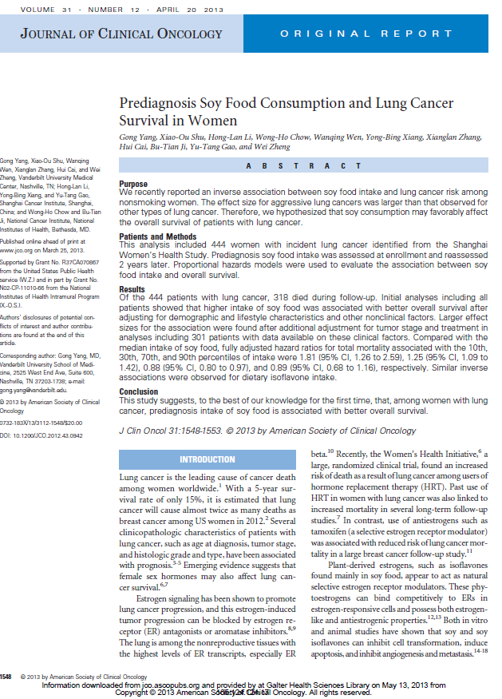
Initial analyses including all patients showed that higher intake of soy food was associated with better overall survival after adjusting for demographic and lifestyle characteristics and other nonclinical factors This study suggests that, among women with lung cancer, prediagnosis intake of soy food is associated with better overall survival.
J. Clinic. Onc. 31:12, 2013

Slide 47
Imagine a product-- not a drug -- powerful enough to help you lower your cholesterol, reduce your risk of heart disease and cancer, improve mood, reduce your weight and provide all your nutrition needs.
Now imagine this product has NO side effects.
You'd surely stock up on a lifetime supply. Guess what? These life-altering superfoods are available right now in your local supermarket.

Slide 48
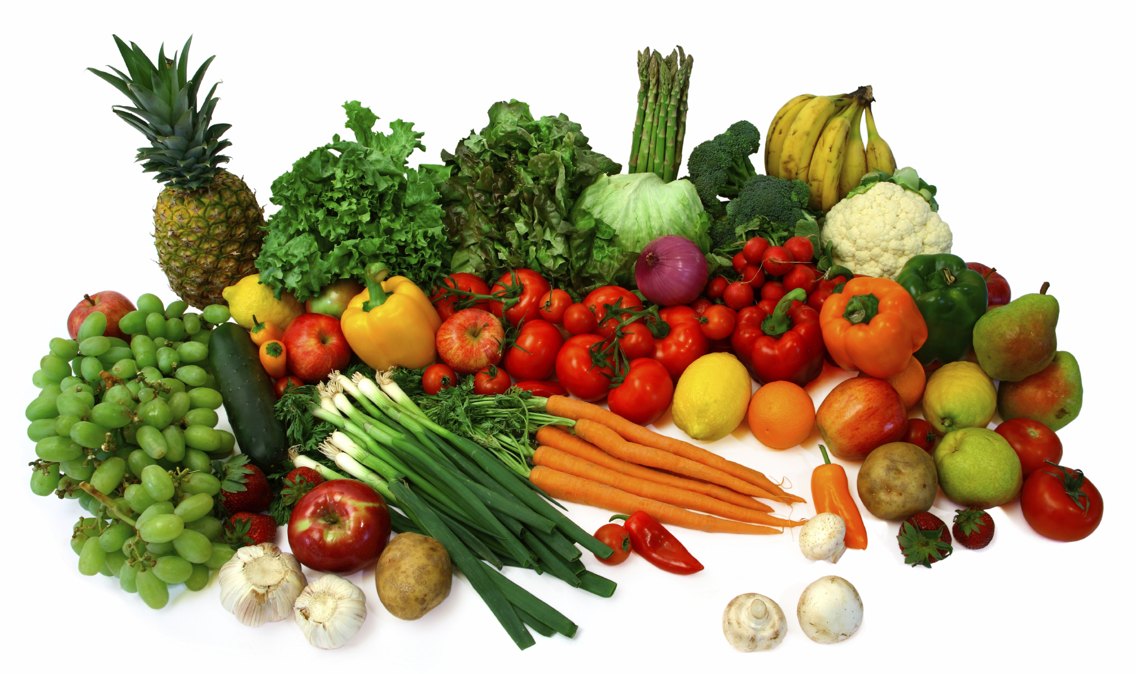

Slide 49
Our nutrition needs are not necessarily chronological
Schedule a visit with your Registered Dietitian for more help with dietary intake

